Slide 1
19CSE305 – Machine Learning Heart Attack Predictor
TEAM MEMBERS
CB.EN.U4CSE21002 - Abhinav Saravanakumar
CB.EN.U4CSE21015 - Dharaneesh P
CB.EN.U4CSE21020 - Guruprasath M
CB.EN.U4CSE21045 - Praveen N

Slide 2
Introduction
This project endeavors to fundamentally transform the landscape of heart attack prediction and prevention. Our team has crafted a sophisticated machine learning model for heart attack prediction, utilizing an array of advanced pre-processing techniques and state-of-the-art machine learning algorithms. Our objective is to optimize the model's efficiency while emphasizing the delivery of precise predictions. Through this endeavor, we aim to usher in a new era of cardiac health monitoring, taking us one step closer to proactive heart attack prevention and improved patient care.

Slide 3
Motivation/Significance
Cardiovascular diseases, notably heart attacks, are a major global health concern, causing a significant number of deaths worldwide, necessitating urgent action.
Our motivation stems from the need to transition from reactive to proactive cardiac health management. Traditional risk factors have limitations, and we aim to enhance heart attack prediction using advanced machine learning techniques.
The project aligns with the trend of personalized medicine, offering tailored care plans based on individual risk factors.
This project has the potential to transform cardiology and showcase the power of machine learning in addressing critical health challenges, paving the way for proactive heart attack prevention and enhanced cardiac healthcare.

Slide 4
Challenges
Obtaining high-quality and comprehensive datasets is often a challenge. Real-life medical data may contain missing values, errors, or inconsistencies, which can affect the model's accuracy.
Healthcare data is sensitive, and there are strict regulations, like HIPAA in the United States, that must be adhered to. Ensuring data privacy and security while working with patient records can be a significant challenge.
Identifying the most relevant features or risk factors for heart attacks can be challenging. Including irrelevant or redundant features can lead to overfitting, while omitting crucial ones can reduce model performance.
Models that work well in one dataset or geographic region may not generalize to others. Adapting models for diverse populations and healthcare systems is a challenge.
Rigorous testing and validation of the model's performance are necessary to ensure it meets the required standards for clinical use.

Slide 5
Dataset Description
UCI Machine Learning Repository
The dataset consists of 303 instances and 14 attributes, including age, sex, chest pain type, resting blood pressure, cholesterol level, fasting blood sugar, electrocardiographic results, maximum heart rate achieved, exercise-induced angina, ST depression, the slope of the peak exercise ST segment, number of major vessels, and thalassemia type.
The primary objective is to predict the presence or absence of heart disease, making it suitable for binary classification tasks.
The dataset includes numerical, categorical, and binary features.
Preprocessing is applied to handle missing values and outliers.
The dataset is credited to the UCI Machine Learning Repository, and appropriate citation guidelines have been followed.

Slide 6
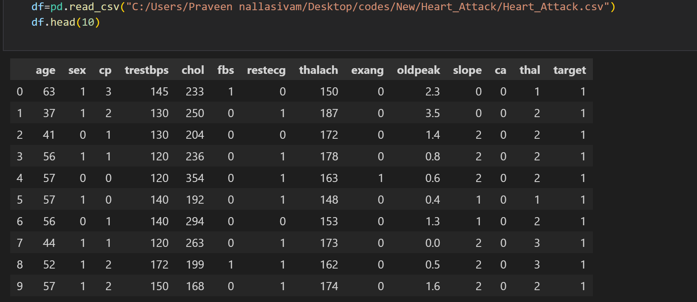
Results
DATA:

Slide 7
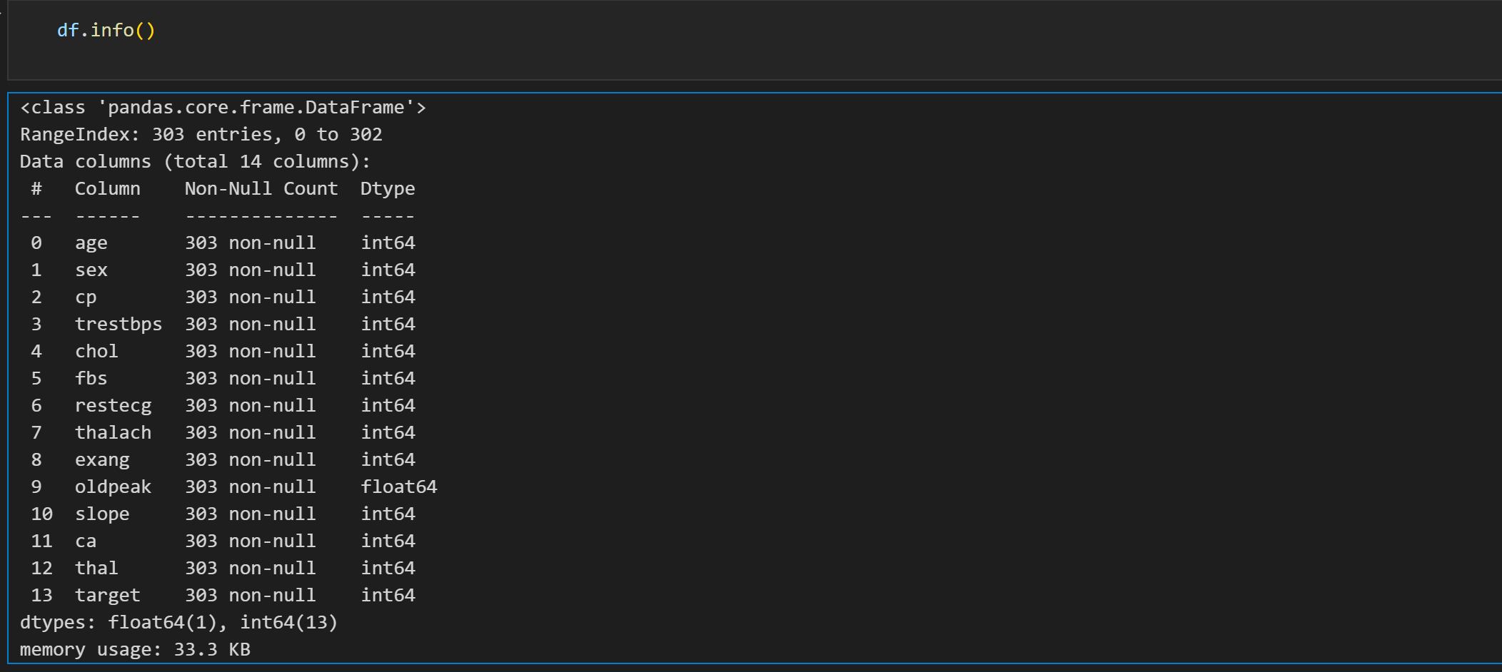
Results
DATA PREPROCESSING:

Slide 8
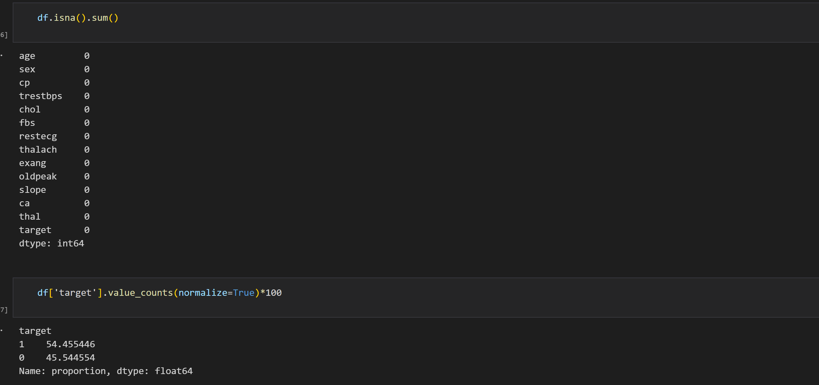
Results
DATA PREPROCESSING:

Slide 9
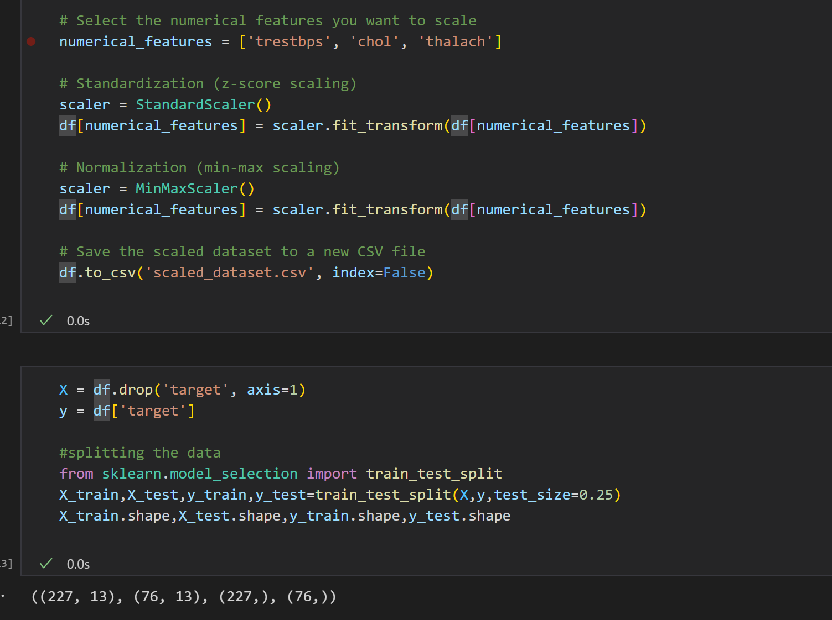
Results
DATA PREPROCESSING:

Slide 10
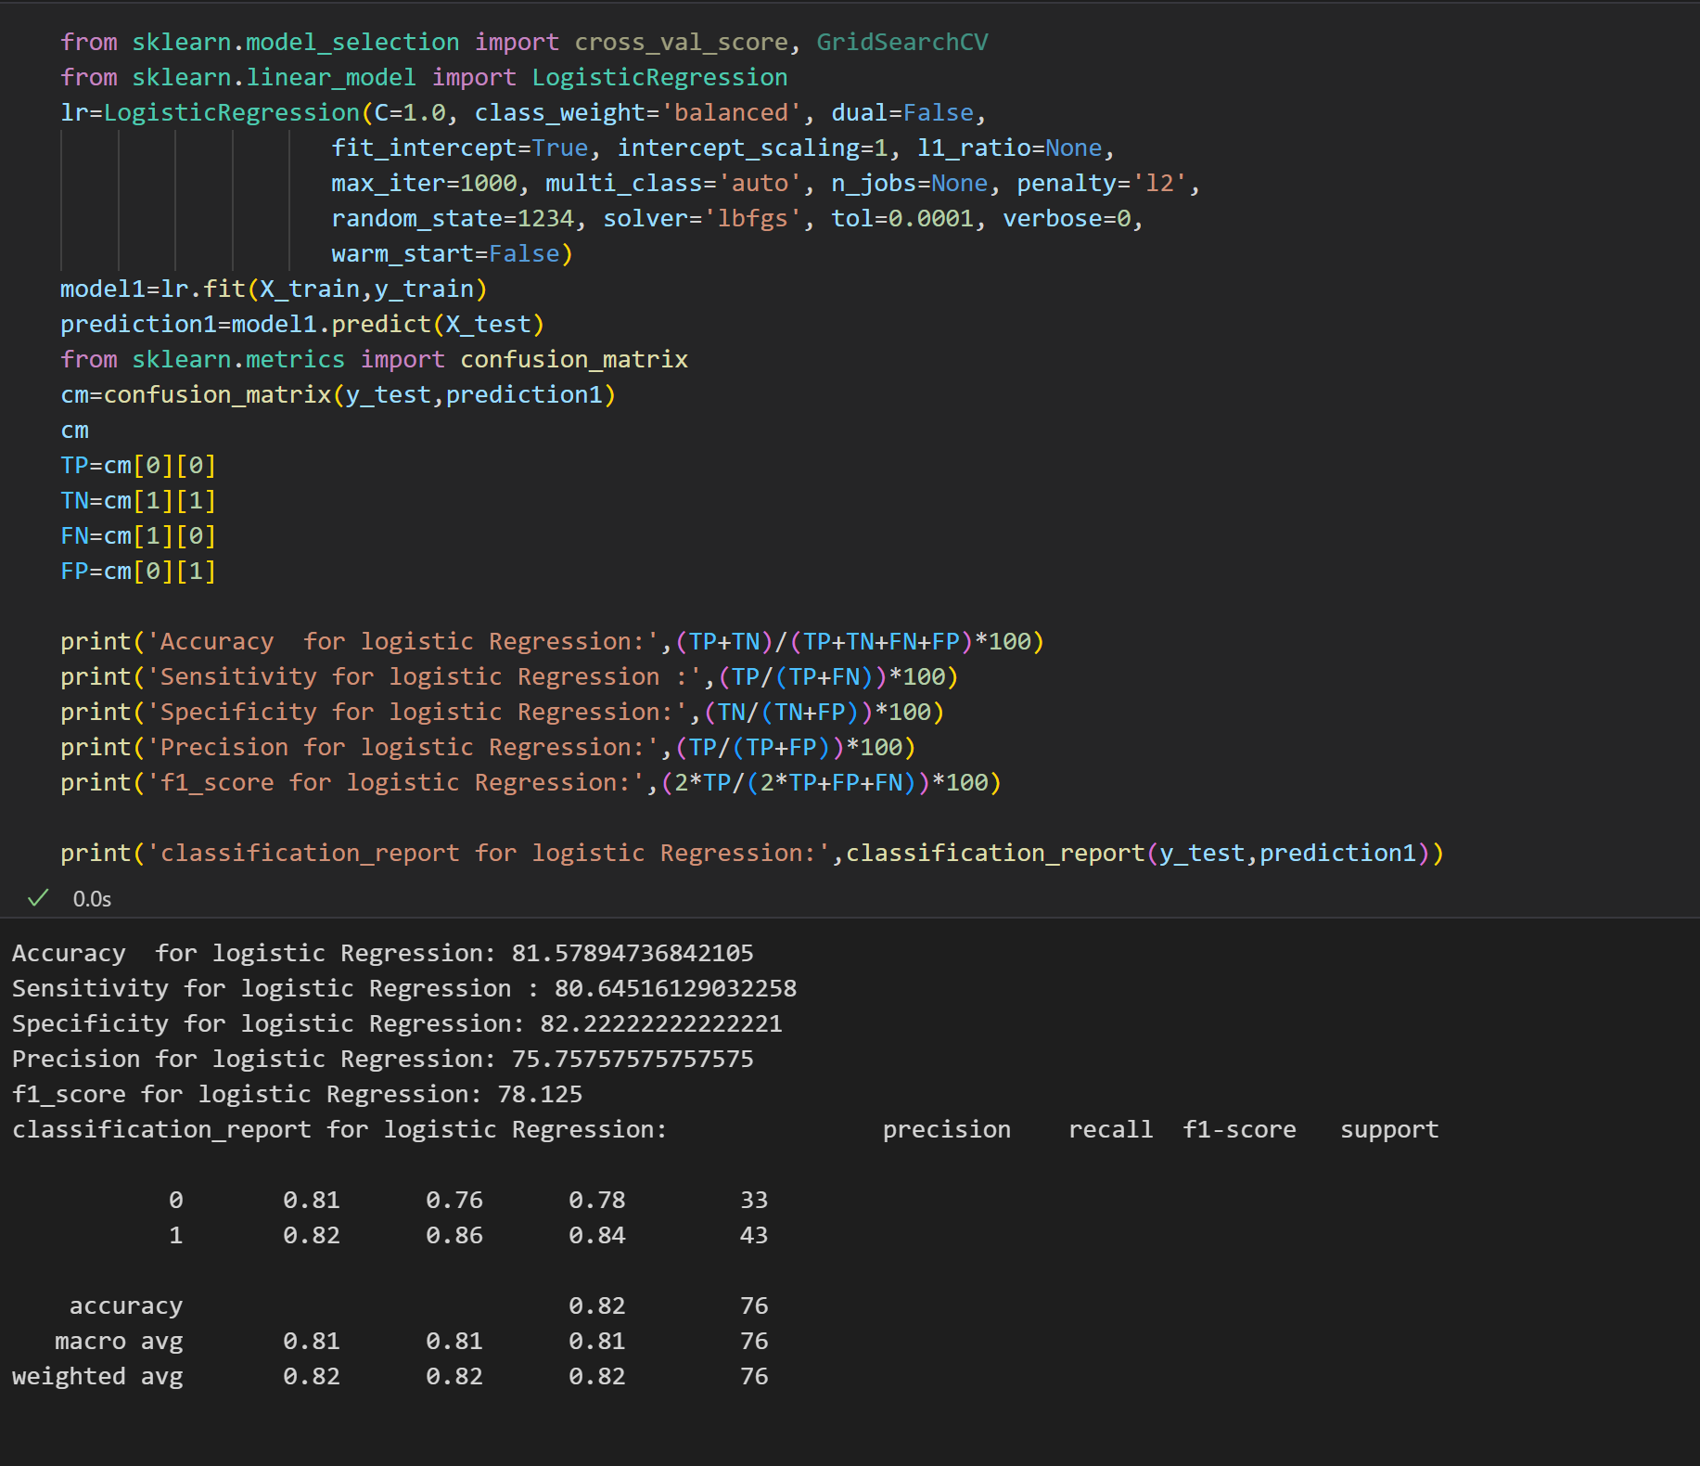
Results
REGRESSION MODEL:

Slide 11
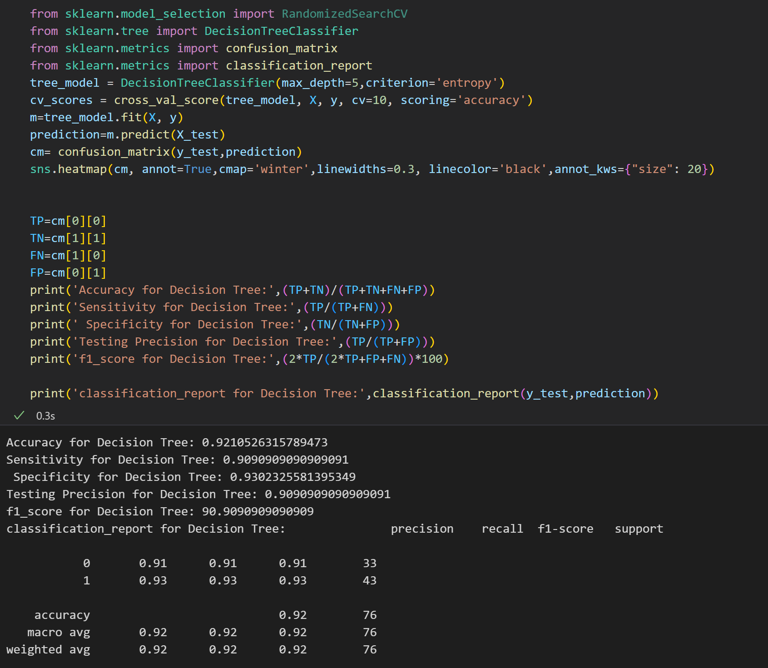
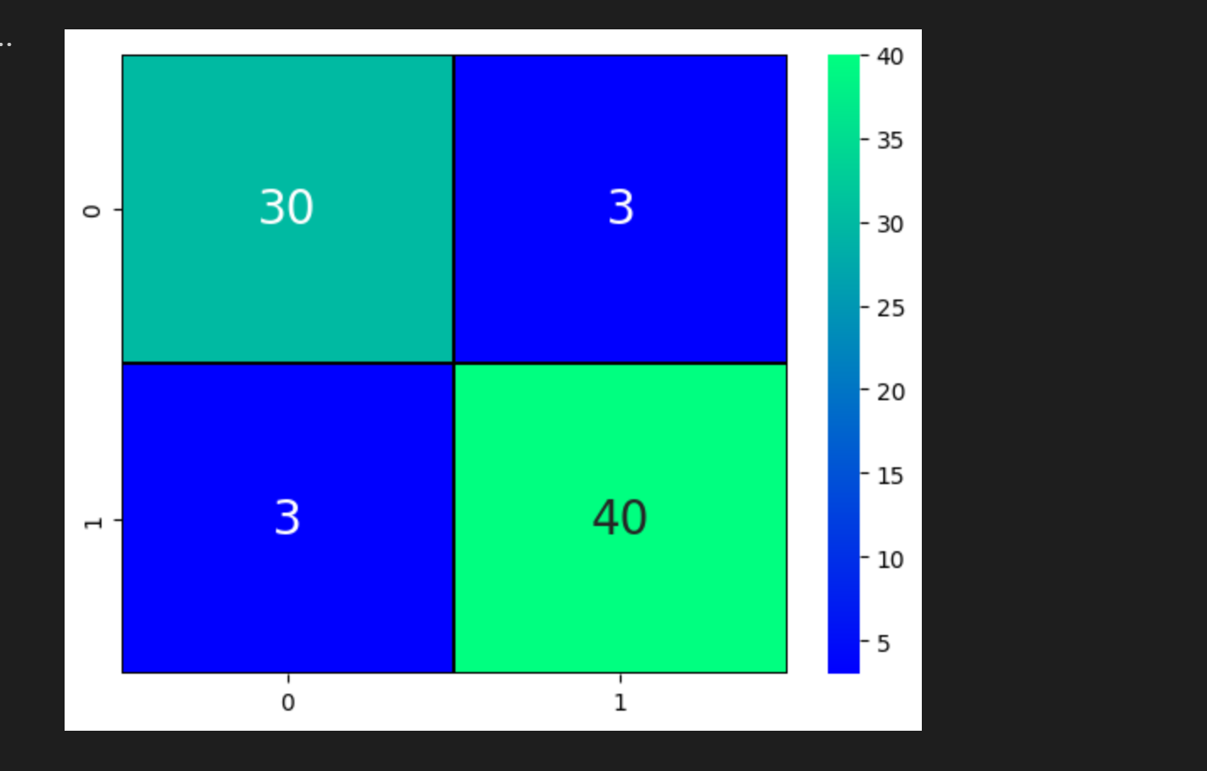
Results
DECISION TREE:

Slide 12
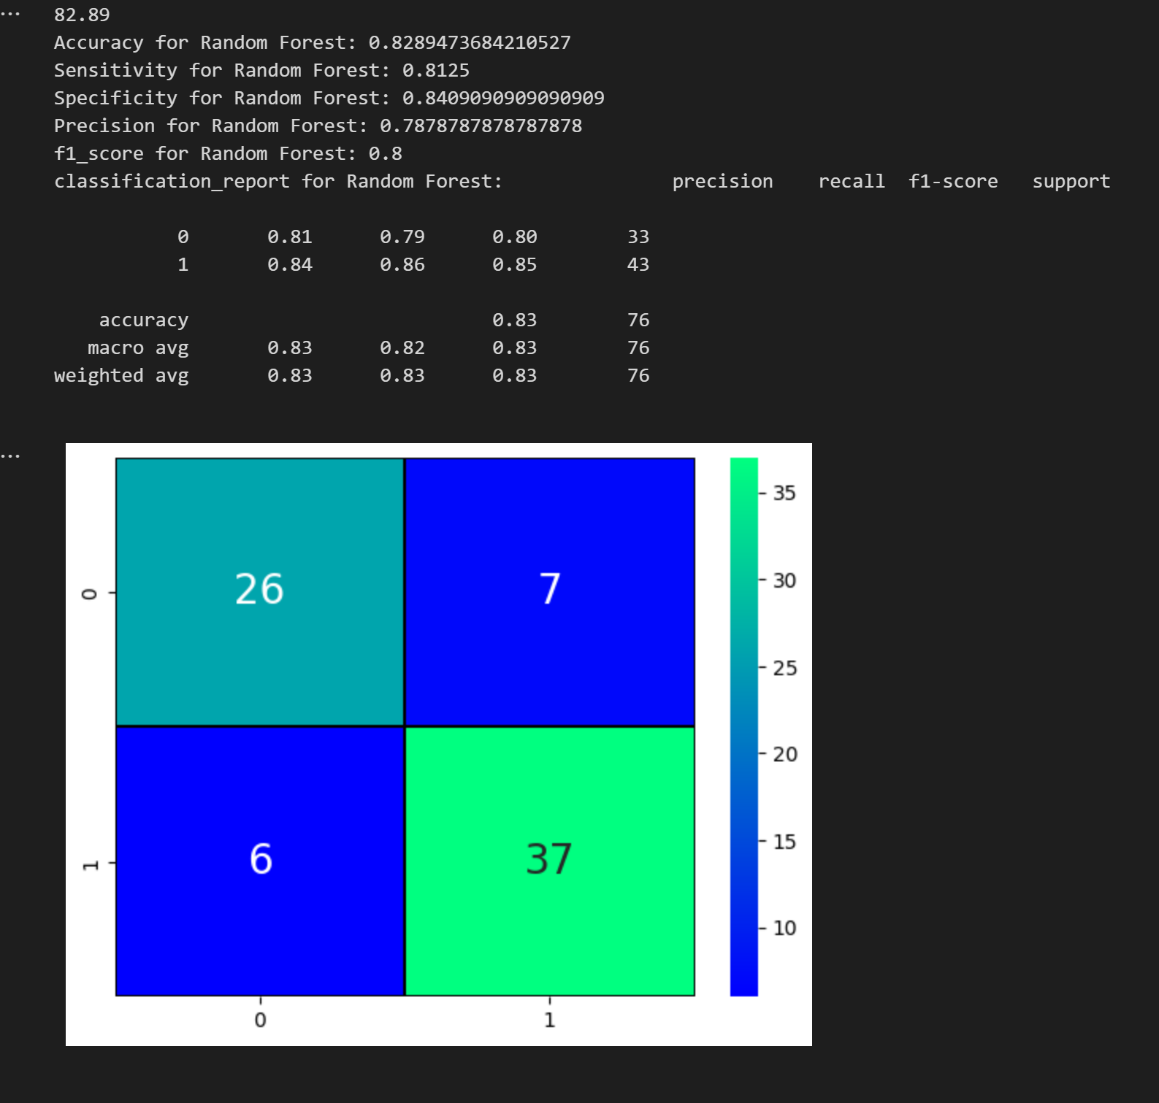
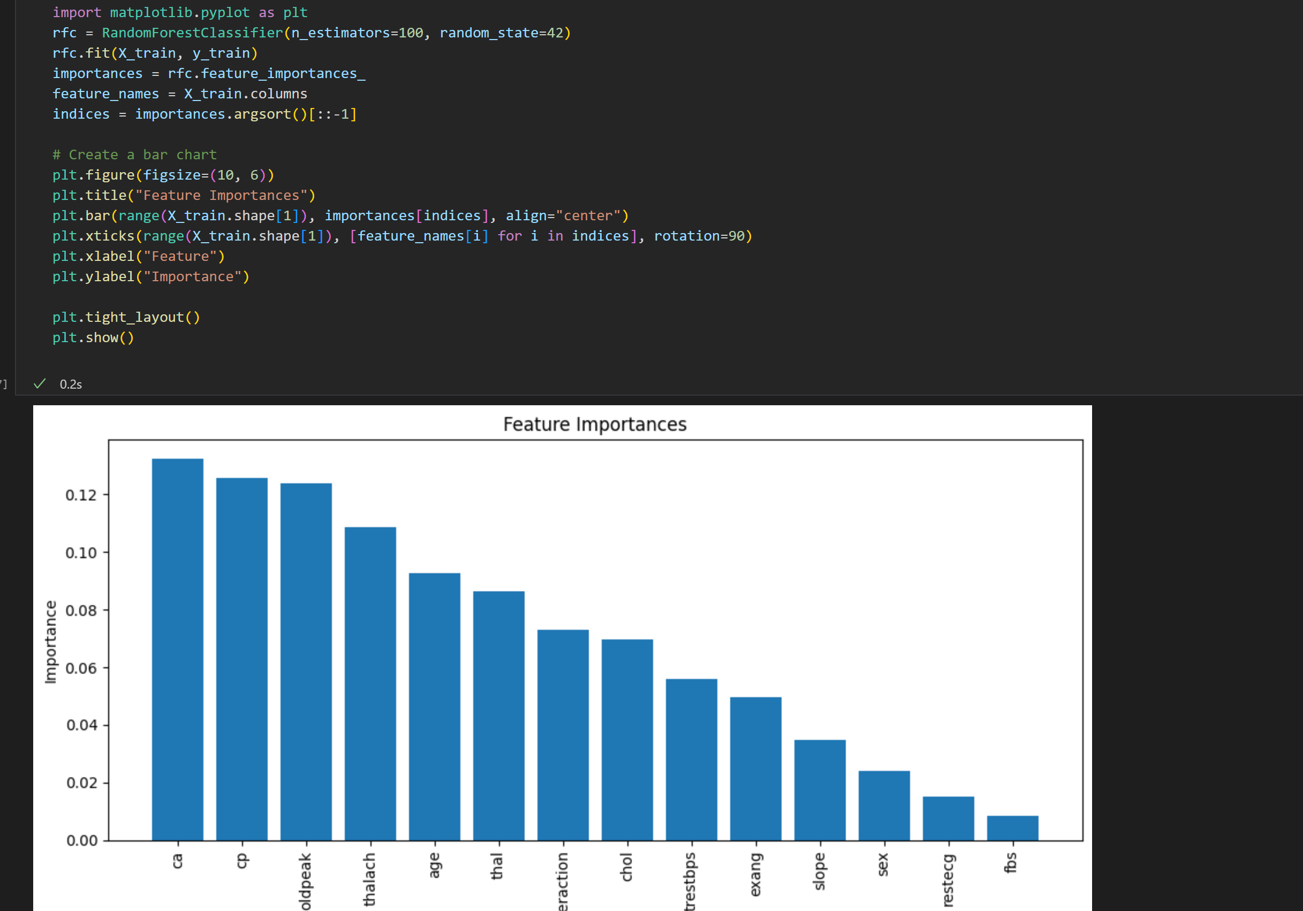
Results
RANDOM FOREST:

Slide 13
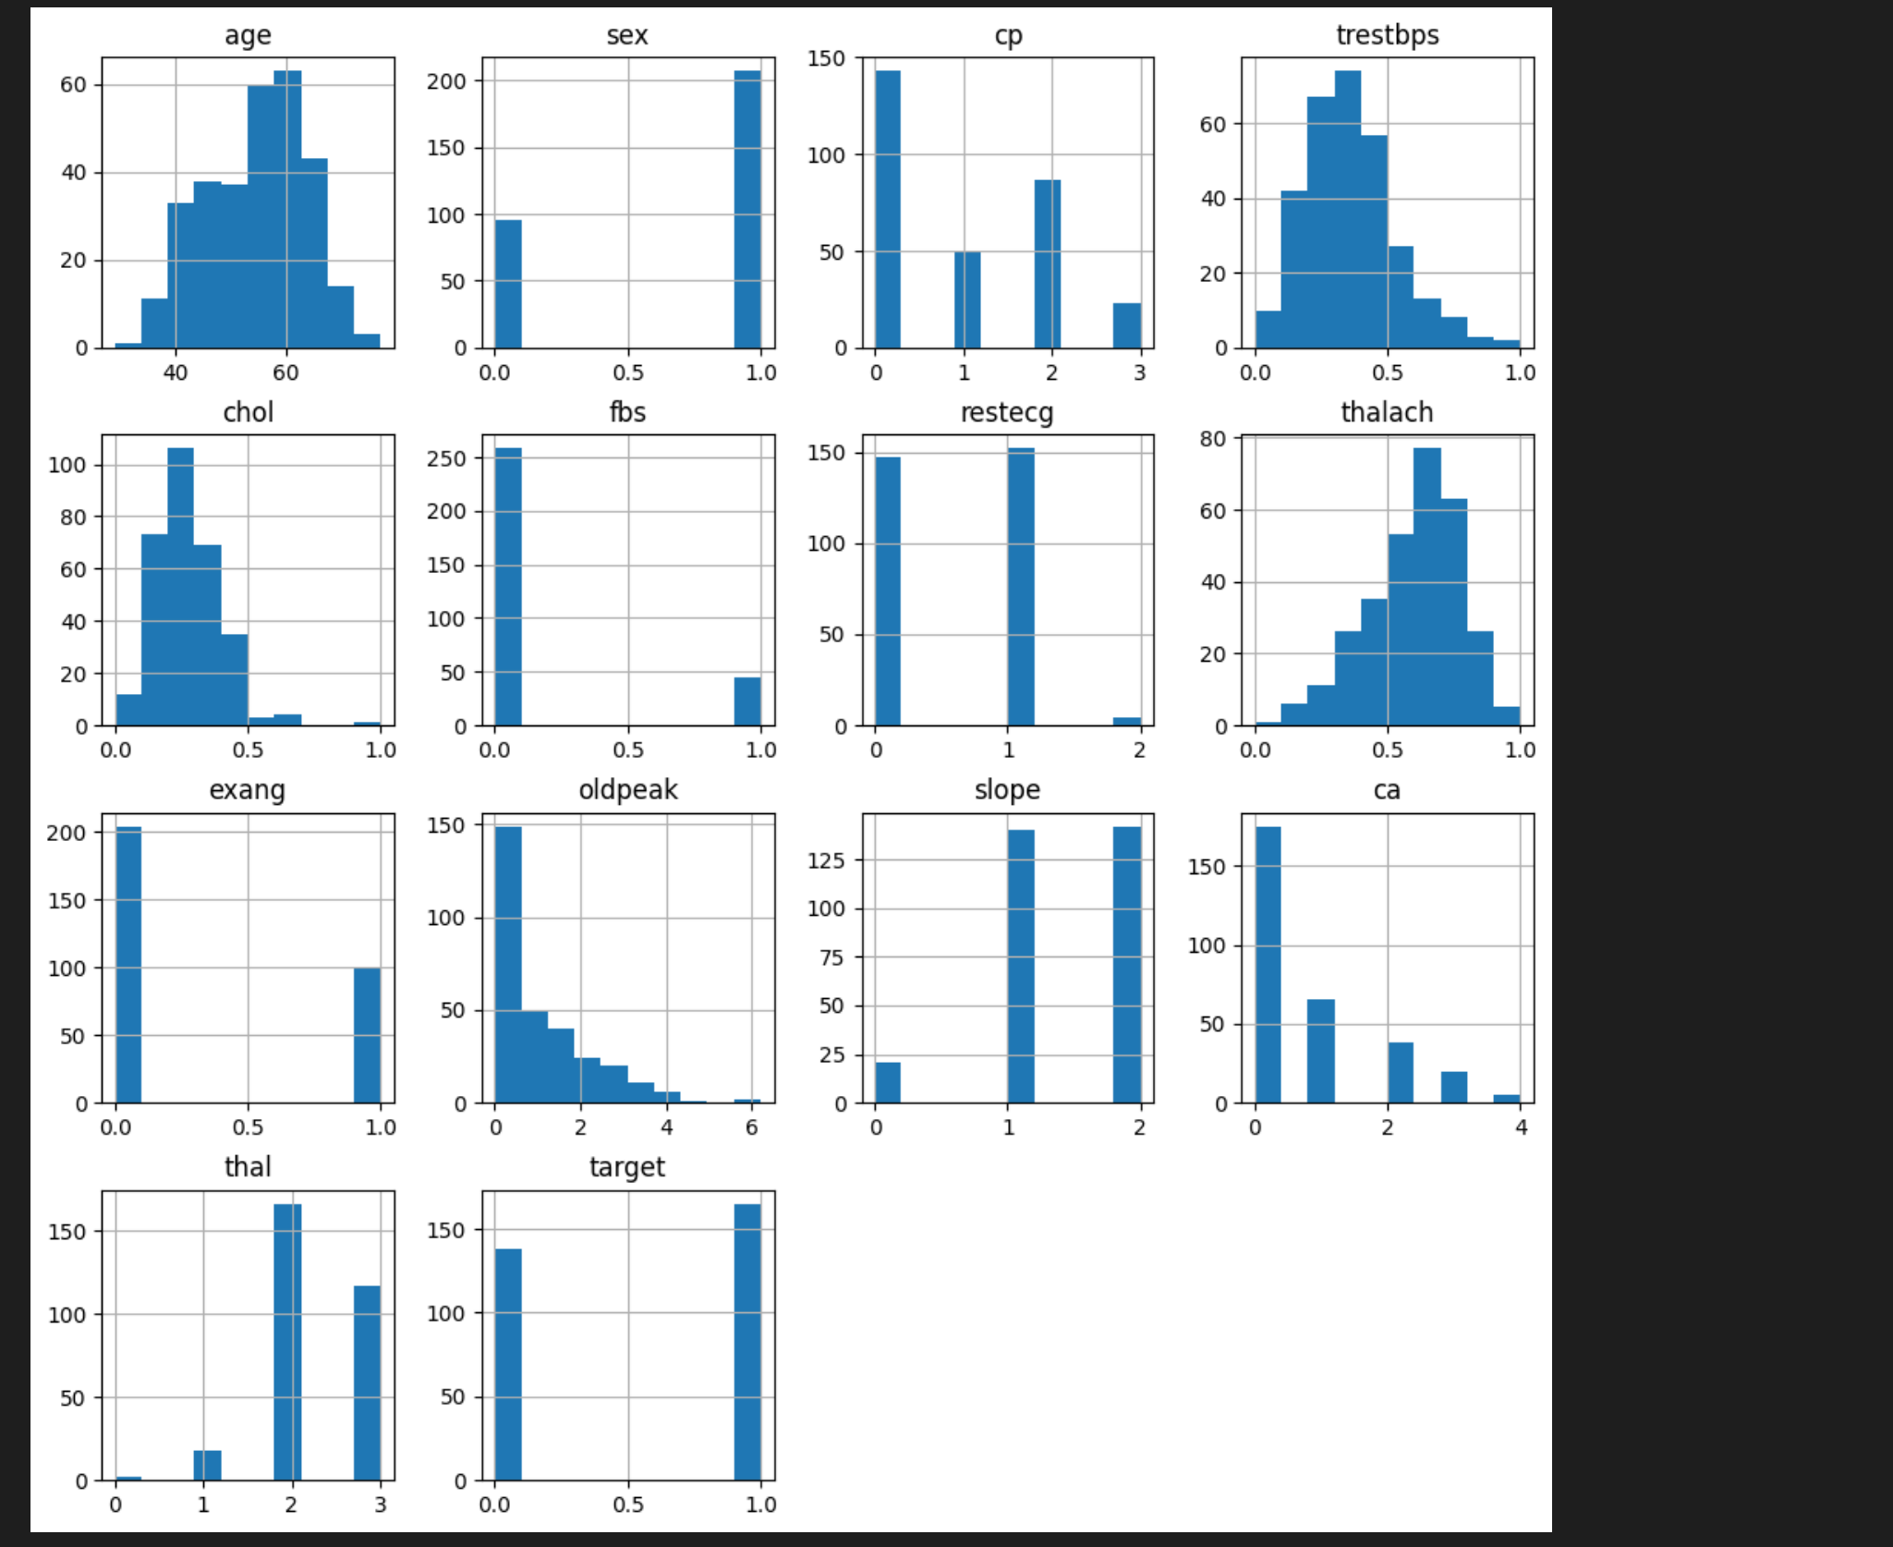
Results
DATA VISUALIZATIONS:

Slide 14
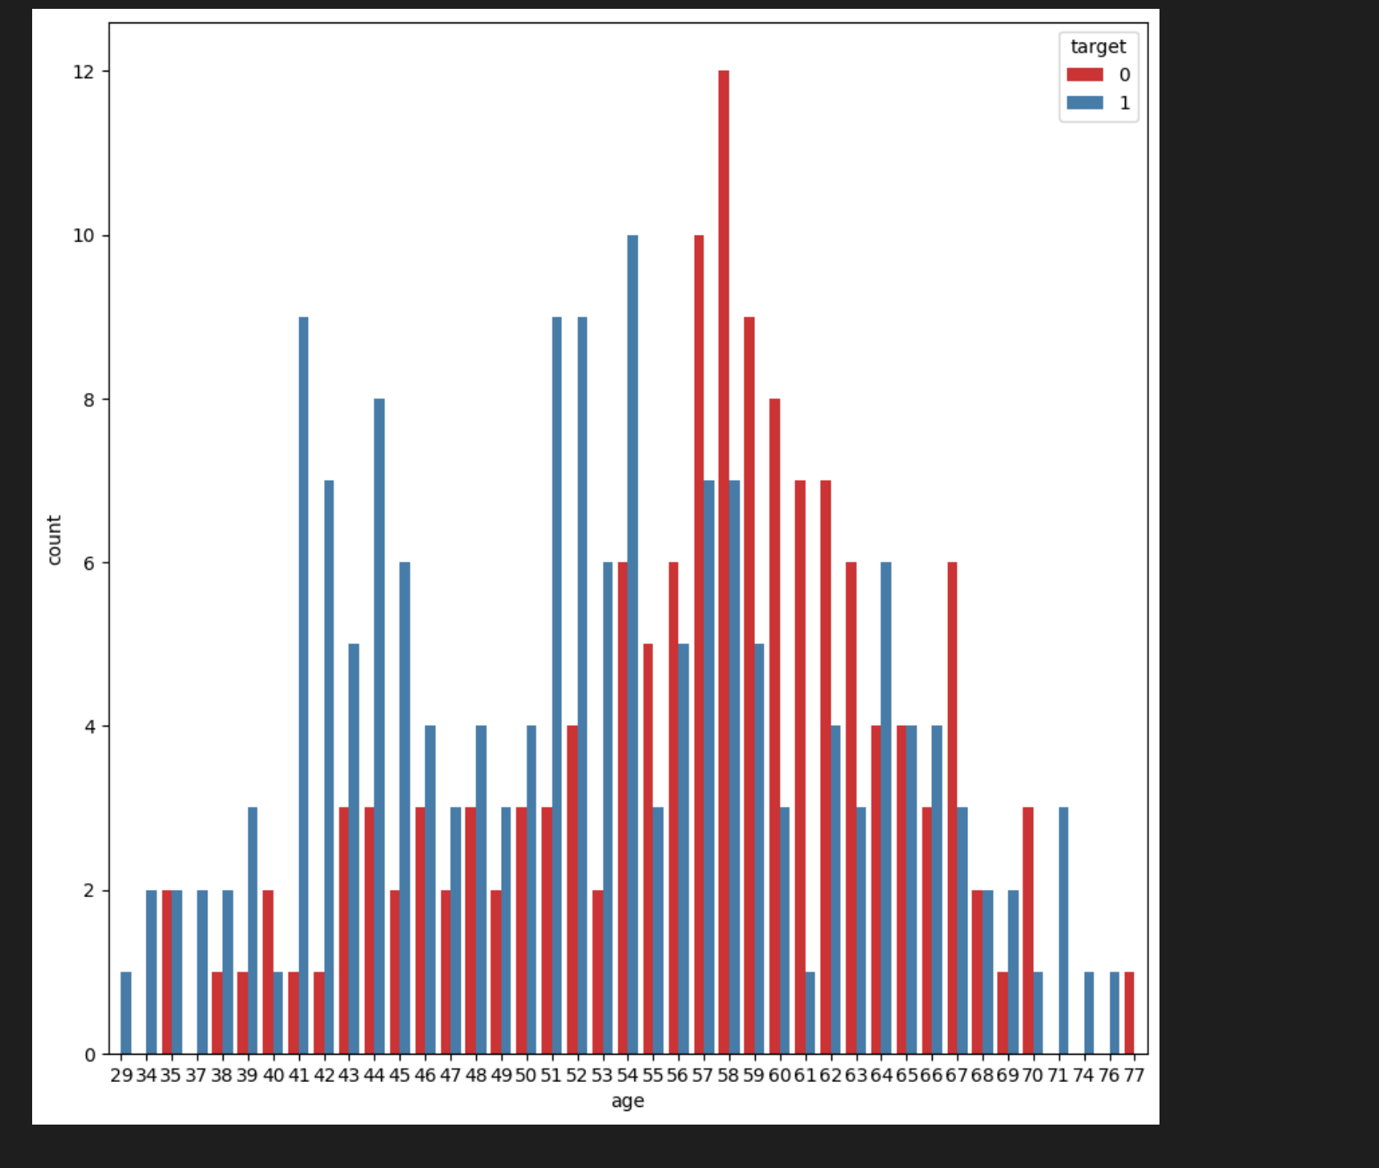
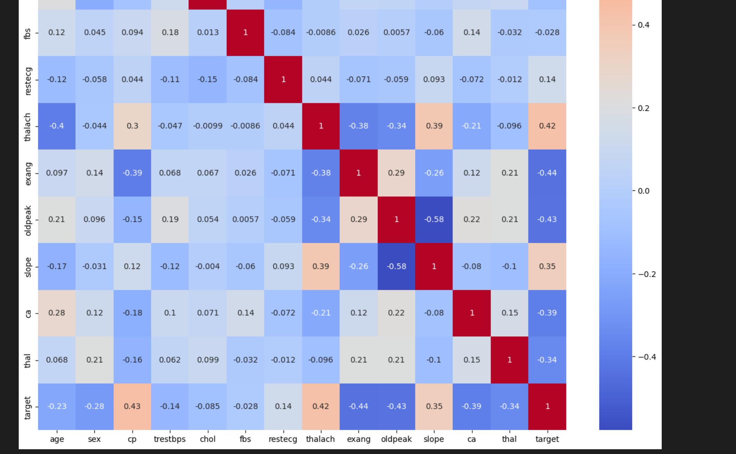
Results
DATA VISUALIZATIONS:

Slide 15
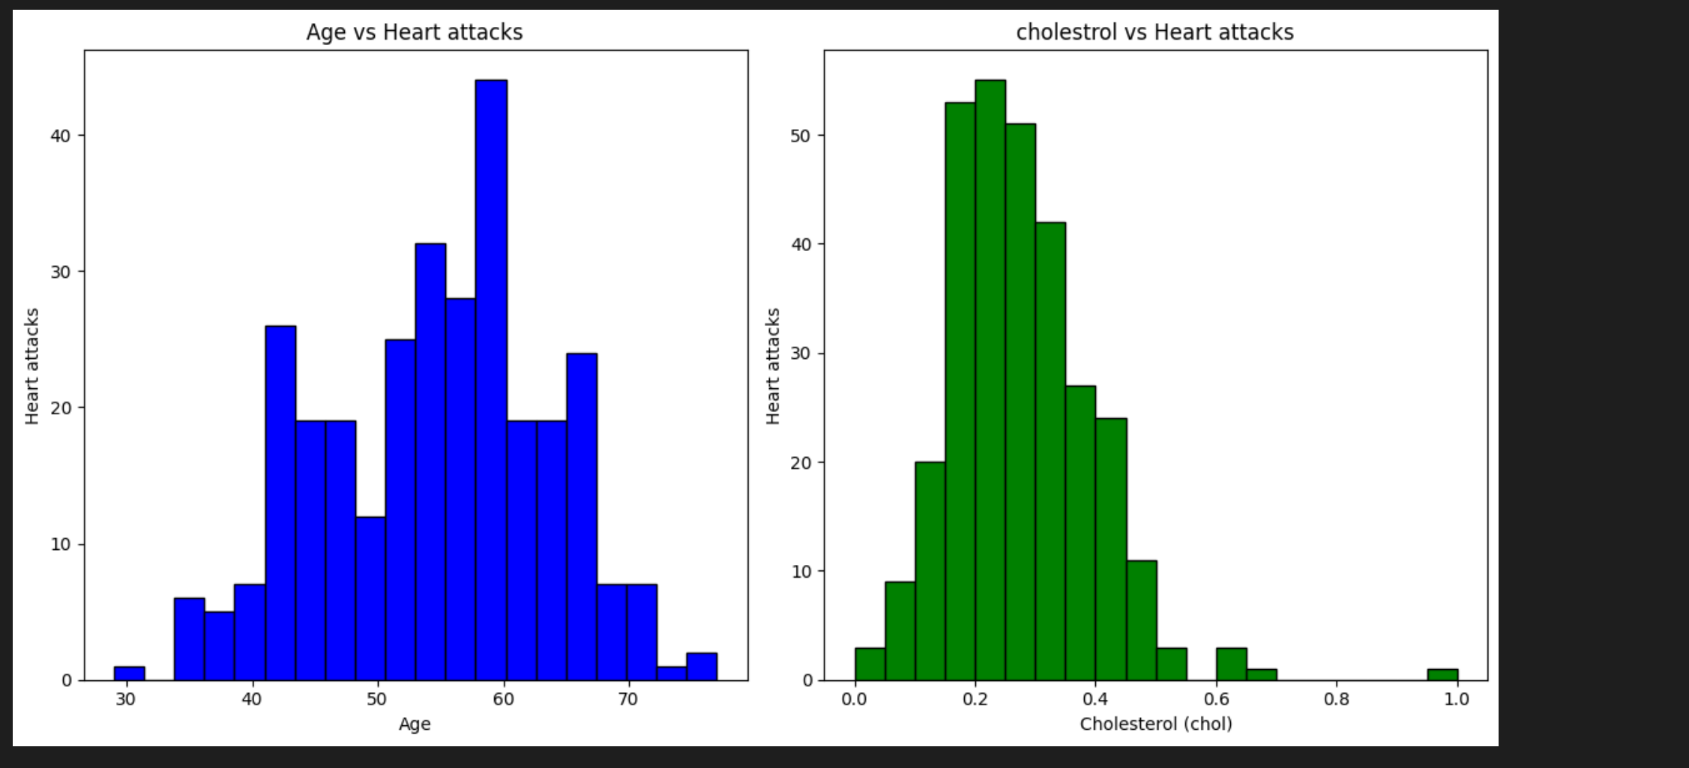
Result Comparison
DATA VISUALIZATIONS:

Slide 16
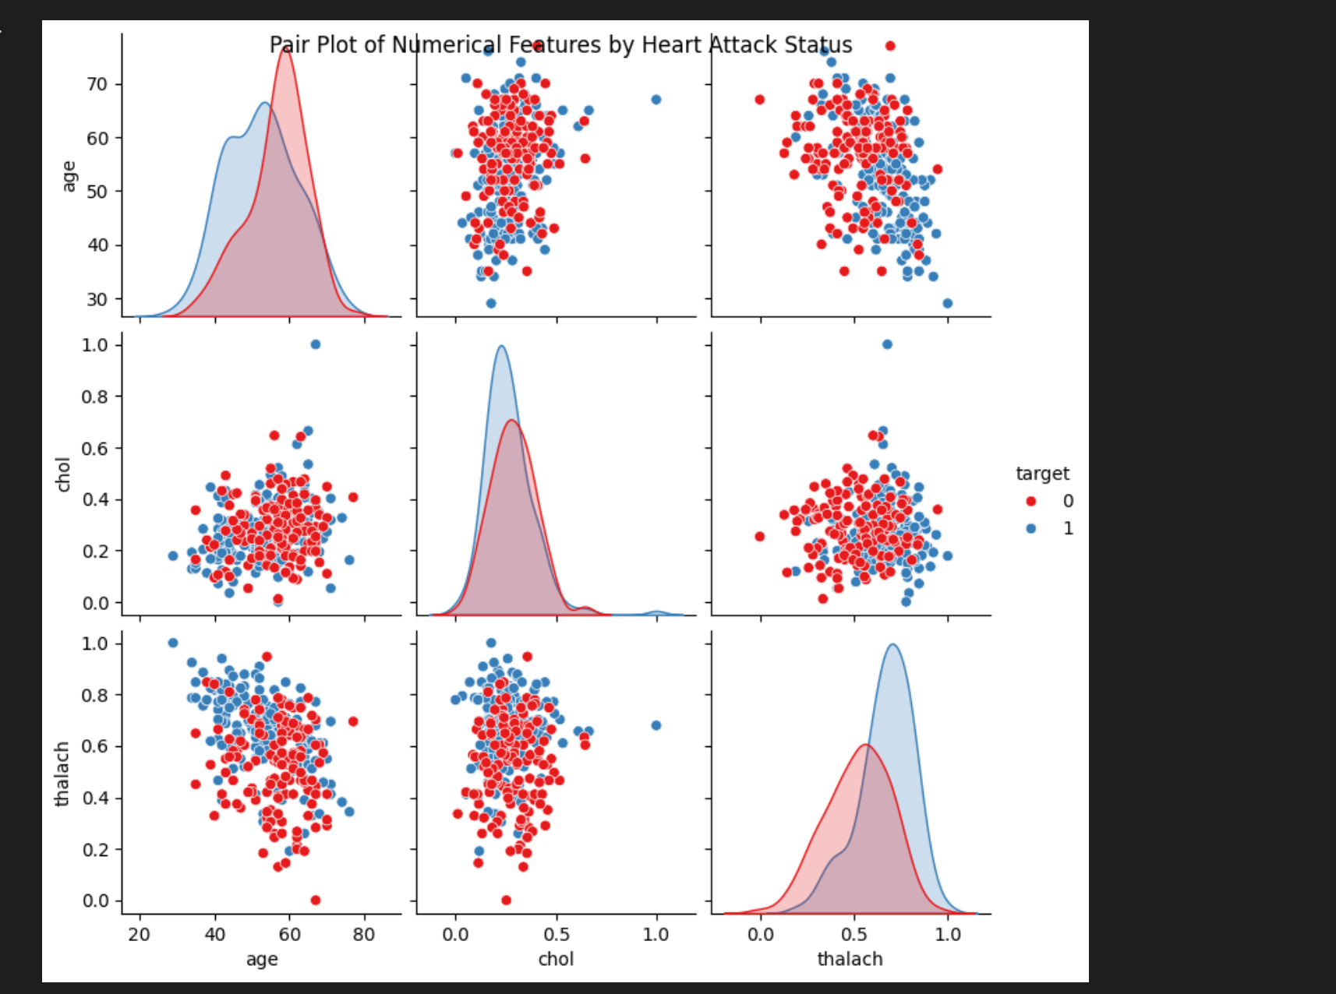
Results
DATA VISUALIZATIONS:

Slide 17
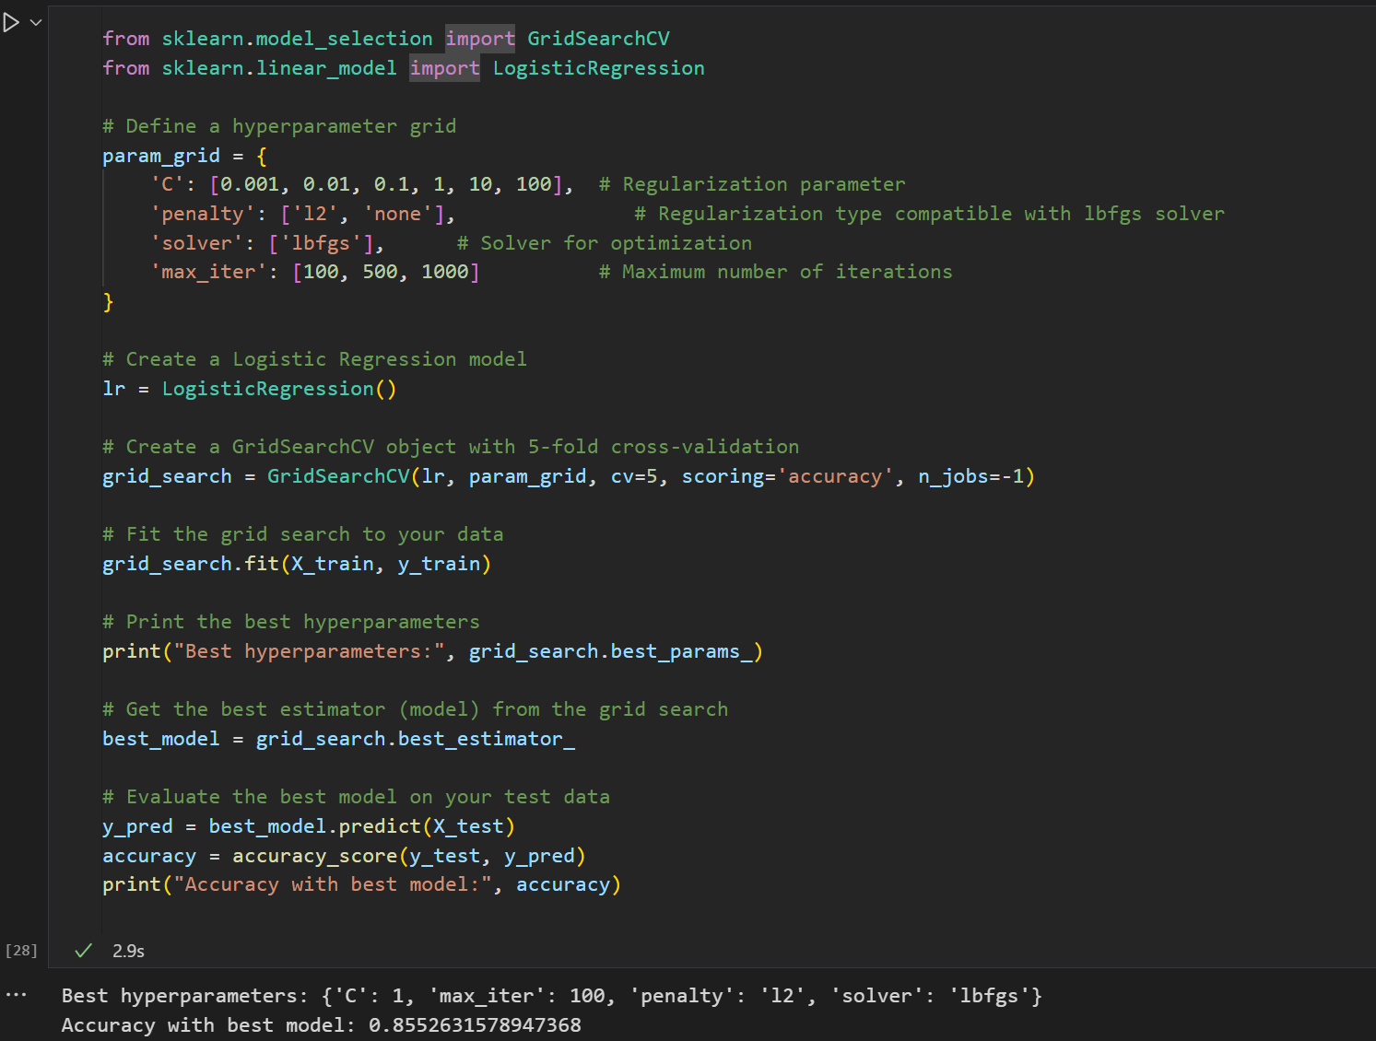
Results
HYPERPARAMETER TUNING:

Slide 18
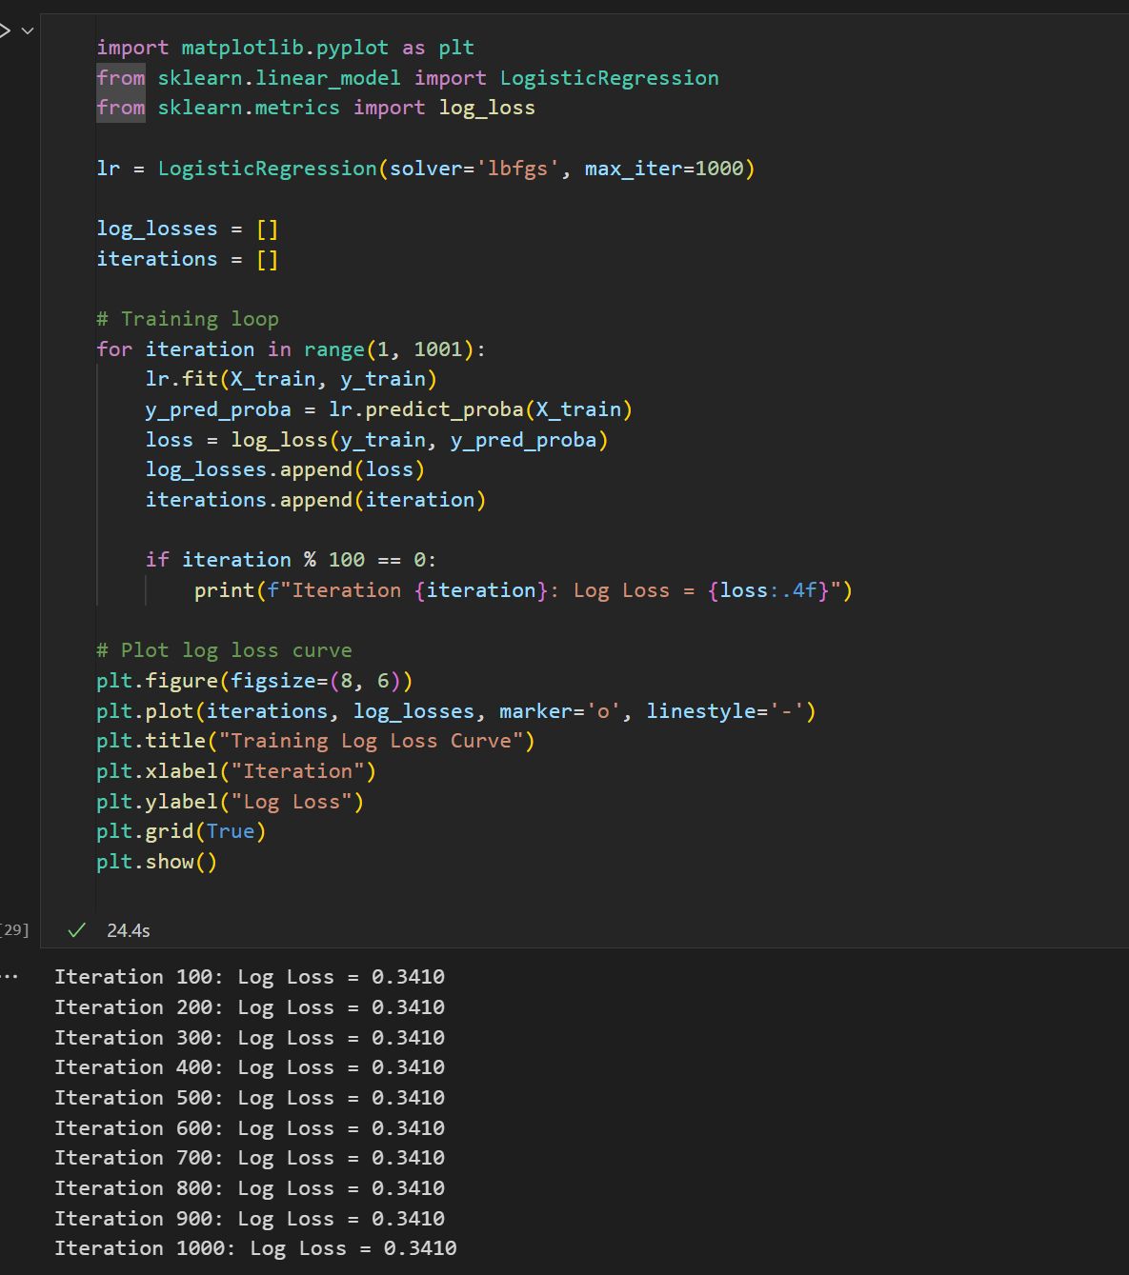
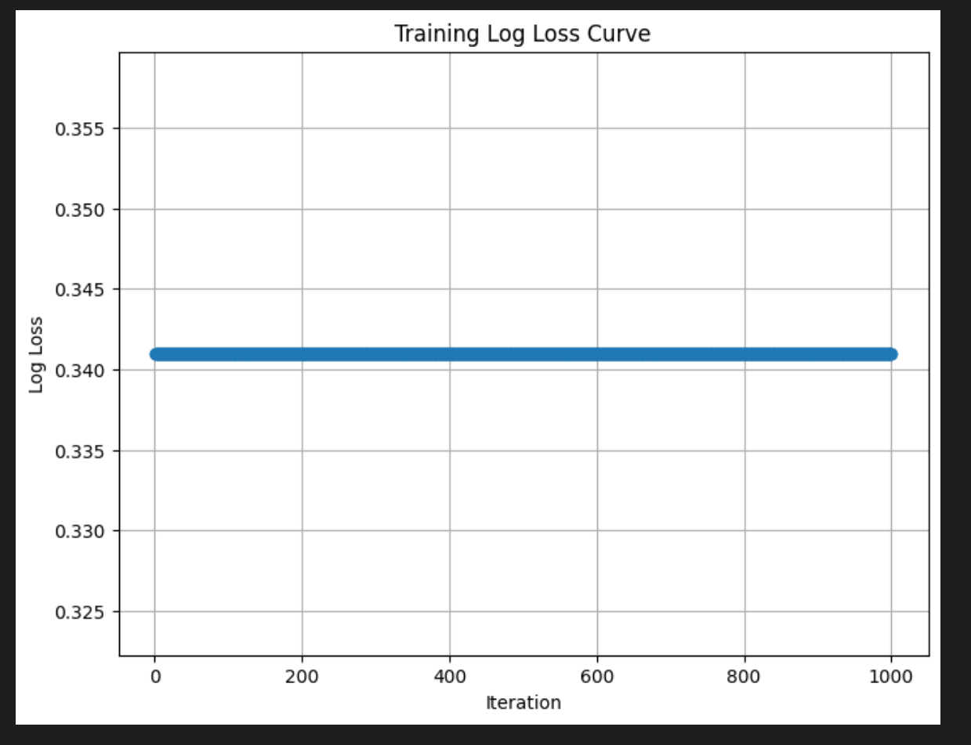
Results
ERROR AND LOSS CURVES:

Slide 19
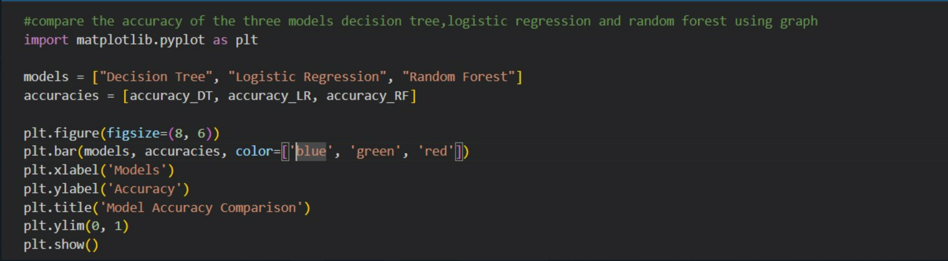
Review 1 final comparision

Slide 20
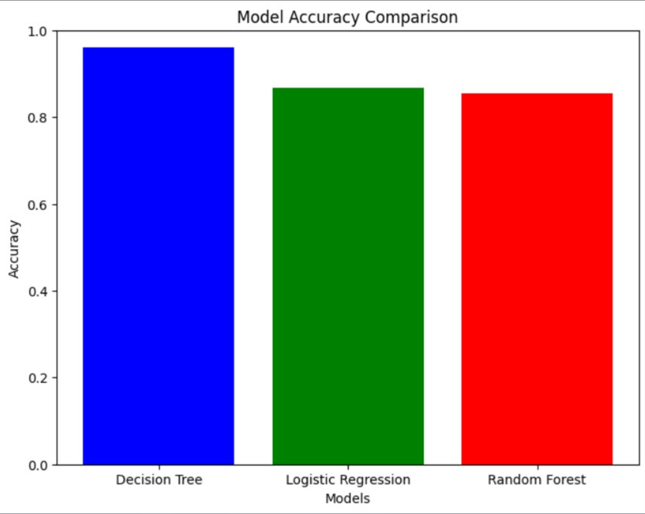
Review 1 final comparision

Slide 21
References
lnk for models:
https://towardsdatascience.com/building-a-logistic-regression-in-python-step-by-step-becd4d56c9c8
https://towardsdatascience.com/random-forest-in-python-24d0893d51c0
https://towardsdatascience.com/an-exhaustive-guide-to-classification-using-decision-trees-8d472e77223f
Papers:
https://ieeexplore.ieee.org/abstract/document/9362842/
https://ieeexplore.ieee.org/document/9848885
https://dl.acm.org/doi/abs/10.1145/3342999.3343015

